Slide 1





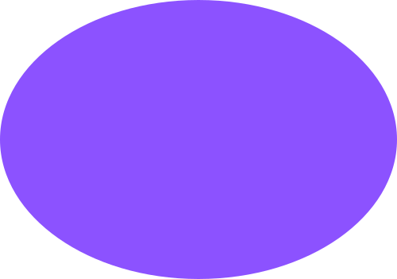
A Control System for the TurtleSim Robot Simulator Based on Hand Gesture Recognition for Drawing Geometric Shapes
BAGDAULETKYZY AKBOTA, MARATOVA AISSULU, YERMAGAMBETOVA MADINA

Slide 2
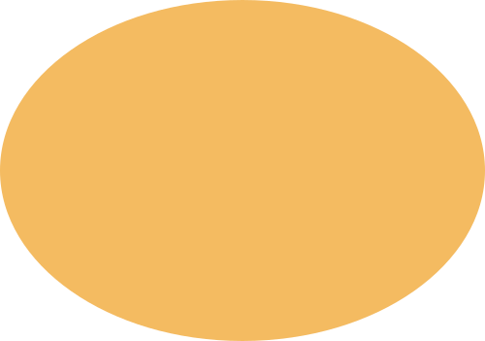

Introduction
Problem Traditional robot control methods (keyboard, joystick, CLI) require technical skills and physical devices.
Solution A natural human-robot interface where the user draws a geometric shape in the air with their index finger, and the TurtleSim robot instantly reproduces it.
Key Features
Real-time hand tracking with MediaPipe
Shape recognition using OpenCV (no machine learning training)
Smooth drawing via ROS 2 and PD controller
Three supported shapes: Circle, Rectangle, Triangle

Slide 3
Related Works & Contribution
Existing Approaches
Sensor gloves / markers (restrict movement)
Static gesture recognition (limited vocabulary)
Deep learning models (require large training datasets)
Our Contribution
Dynamic shape drawing instead of static gestures
No pre-training required
Combines MediaPipe + OpenCV + ROS 2
High accuracy (85% average) with deterministic algorithm
Smooth trajectory reproduction using PD controller
Advantage: User simply draws what they want — no need to memorize gesture commands.

Slide 4

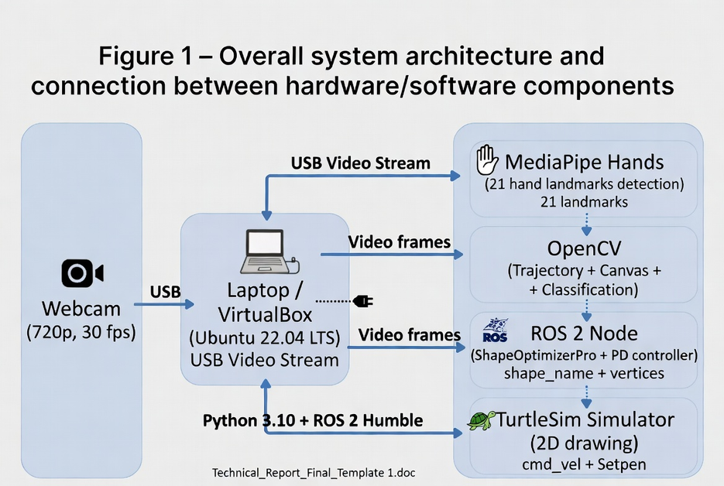
System Architecture
Main Components
Hardware: Webcam + Laptop (Ubuntu 22.04 + VirtualBox)
Software Pipeline:
Video Capture
MediaPipe Hands (21 landmarks)
Trajectory Accumulation + Canvas
Shape Classification Engine
ROS 2 Control Node (PD controller)
TurtleSim Simulator
Communication: ROS 2 topics and services (cmd_vel, set_pen, pose)

Slide 5
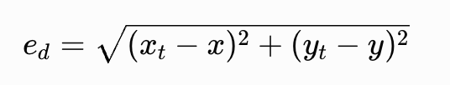
PD Controller for Turtle Navigation
PD Controller for Turtle Navigation
The robot uses a Proportional-Derivative (PD) controller to follow the generated trajectory smoothly and accurately.
The controller continuously calculates two types of errors:
1. Distance Error Difference between the turtle position and target waypoint.
2. Angle Error Difference between the turtle orientation and the desired direction.
Distance Error Equation
Where:
x_t, y_t = target waypoint
x, y = current turtle position
This determines how far the turtle is from the target and enables real-time trajectory correction for smooth shape drawing.

Slide 6


Desired Angle Equation & Angle Error Normalization
Desired Angle Equation:
This calculates the direction toward the waypoint.
Angle Error Normalization:
This keeps the angle error between:
−π
+π
and prevents unstable rotations (wrap-around issue).

Slide 7
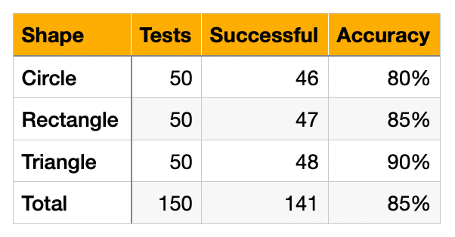

Experimental Results
Accuracy (150 trials)
Average Times
Hand detection: 0.03 s
Shape classification: 0.01 s
Drawing in TurtleSim: 3.5 – 6.0 s
Main Error Sources: hand tremor, very small/fast gestures, extreme aspect ratios.

Slide 8
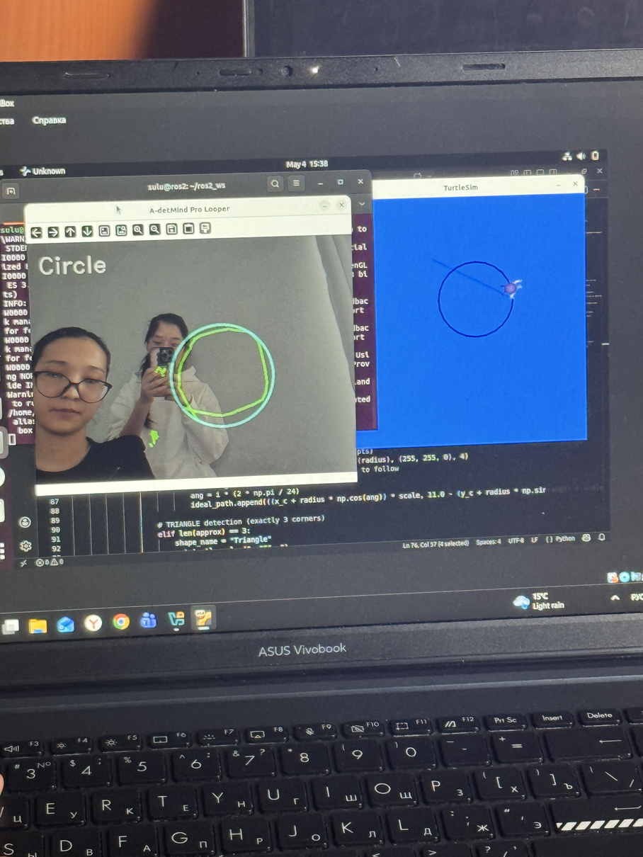
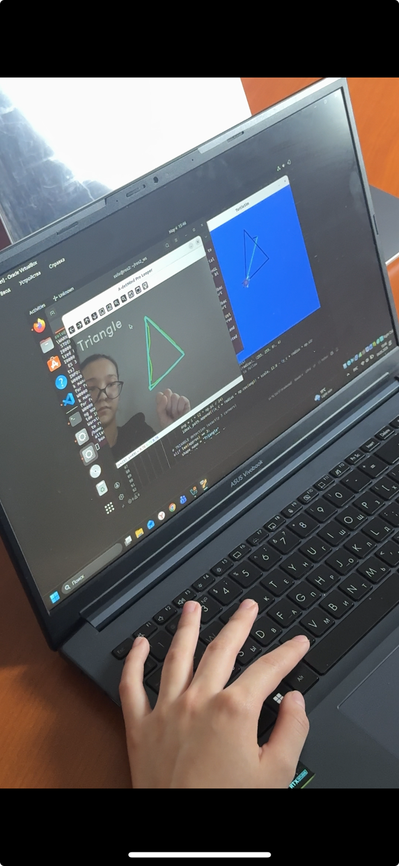
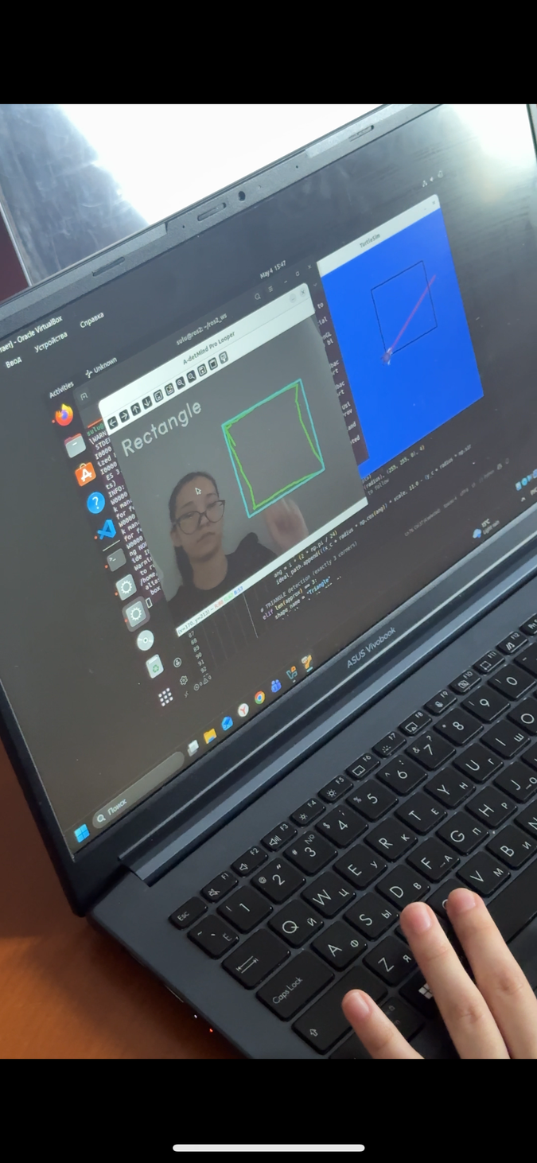
DEMO

Slide 9
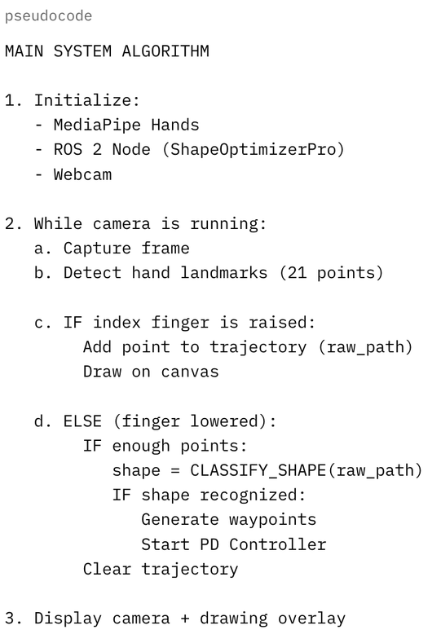
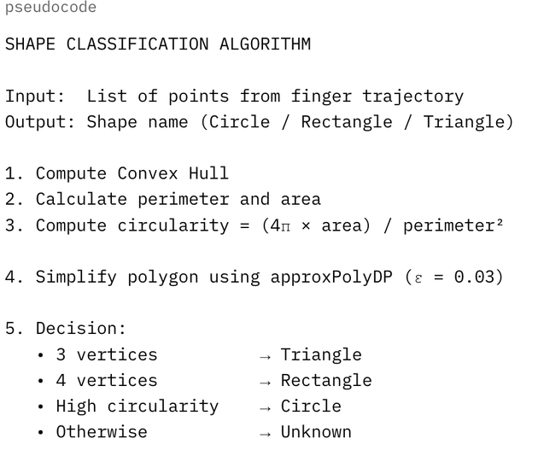
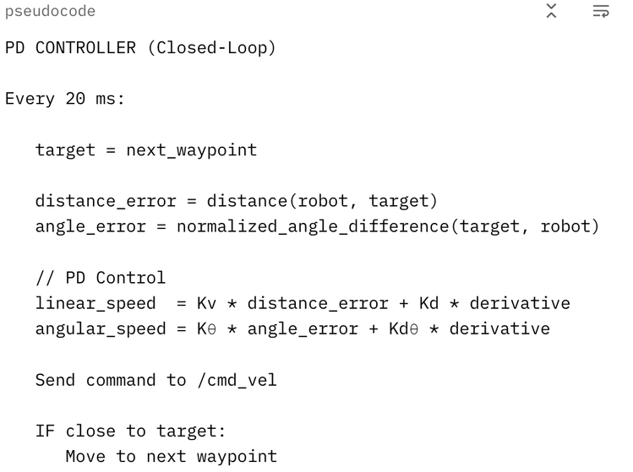
SHAPE CLASSIFICATION ALGORITHM
PD CONTROLLER
PD CONTROLLEROVERALL SYSTEM WORKFLOW

Slide 10
Conclusion
Successfully developed an intuitive hand-gesture control system for TurtleSim.
Achieved 85-90% recognition accuracy under normal lighting.
Demonstrated a complete perception–processing–action loop using only open-source tools.
The system is simple, cost-effective, and suitable for robotics education.

Slide 11

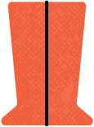
THANK YOU FOR ATTENTION

